Slide 1
INTRODUCTION TO WEB DEVELOPMENT - SESSION 2
Stojancho Jefremov - stojanco.jefremov@gmail.com

Slide 2

Agenda for today
Virtues of a developer
@SEDC 2018-2019

Slide 3
SIX VIRTUES OF A DEVELOPER
@SEDC 2018-2019

Slide 4
THE VIRTUES
Hubris
Impatience
Laziness
@SEDC 2018-2019

Slide 5
Hubris
Excessive pride, the sort of thing Zeus zaps you for.
The quality that makes you write programs that other people won't want to say bad things about.
The quality that makes you go back to a working program saying “I can do better”.
The quality that makes you strive to write the next great piece of software
@SEDC 2018-2019

Slide 6
Impatience
The anger you feel when the computer is being lazy.
What you can and do right now is what matters, not what will happen “some day”.
Perfect is the enemy of good (especially good enough).
This makes you write programs that don't just react to your needs, but actually anticipate them.
This makes you write programs that other people will enjoy using
@SEDC 2018-2019

Slide 7
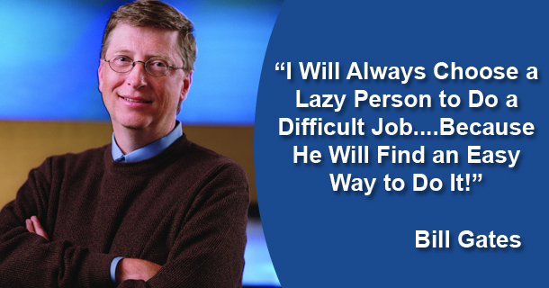
Laziness
@SEDC 2018-2019

Slide 8
Laziness
The quality that makes you go to great effort to reduce overall energy expenditure.
It makes you make the computer work instead of you
It makes you write labor-saving programs that other people will find useful
It makes you document what you wrote so you don't have to answer so many questions about it.
@SEDC 2018-2019

Slide 9
THE VIRTUES
Hubris
Humility
Impatience
Endurance
Laziness
Perseverance
@SEDC 2018-2019

Slide 10
Humility
The quality that makes you recognize greatness when you see it
The quality that makes you ask stupid questions and get labor-saving results.
The quality that makes you go back to a working program and replace your code with someone else’s superior implementation.
The quality that makes become a better programmer than you were six months ago
@SEDC 2018-2019

Slide 11
Endurance
The ability to keep going through a seemingly bizarre situation.
The ability to test and stress an application over and over again until it fails.
Good is the enemy of perfect (especially good enough).
This makes you write programs that won’t crash as soon as people start actually using them.
This makes you write programs that other people will enjoy using.
@SEDC 2018-2019

Slide 12
Perseverance
The quality that makes you invest your energy on a single task for prolonged amount of time.
It makes you able to focus on a issue to the exclusion of the rest of the world
It makes you do the work of the computer, until you show it what it did wrong
@SEDC 2018-2019

Slide 13
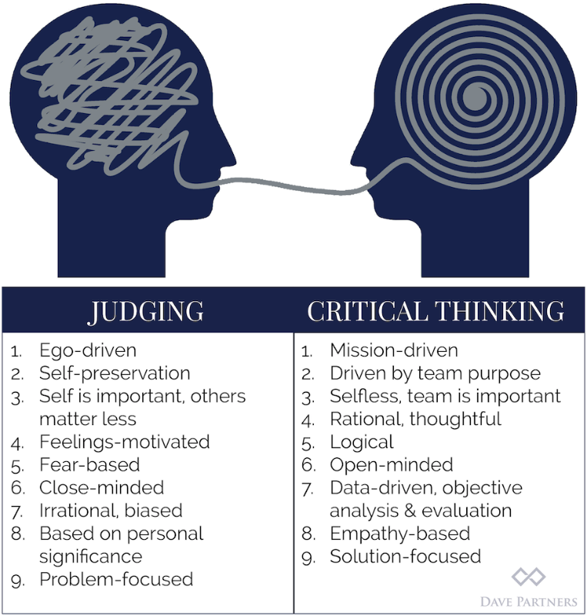
Bonus one - critical thinking
@SEDC 2018-2019

Slide 14
Bonus one - critical thinking
Do not take anything for granted.
Story about chicken.
@SEDC 2018-2019

Slide 15
In a nutshell
Got to see both the forest and the trees (at the same time)
Got to be passionate and clear headed
Got to deliver quality while cutting corners
Got to be fearless yet cautious
Got to be curious and focused
Got to be a team player but never a pushover
@SEDC 2018-2019

Slide 16
What we talked about
Virtues of a developer
@SEDC 2018-2019

Slide 17

Time for questions!
@SEDC 2018-2019

